Slide 1
CNSCC406
Broadband Communications
Lecture 1 Introduction and wireless challenges
Dr Qiao Cheng
qiao.cheng@lancaster.ac.uk

Slide 2
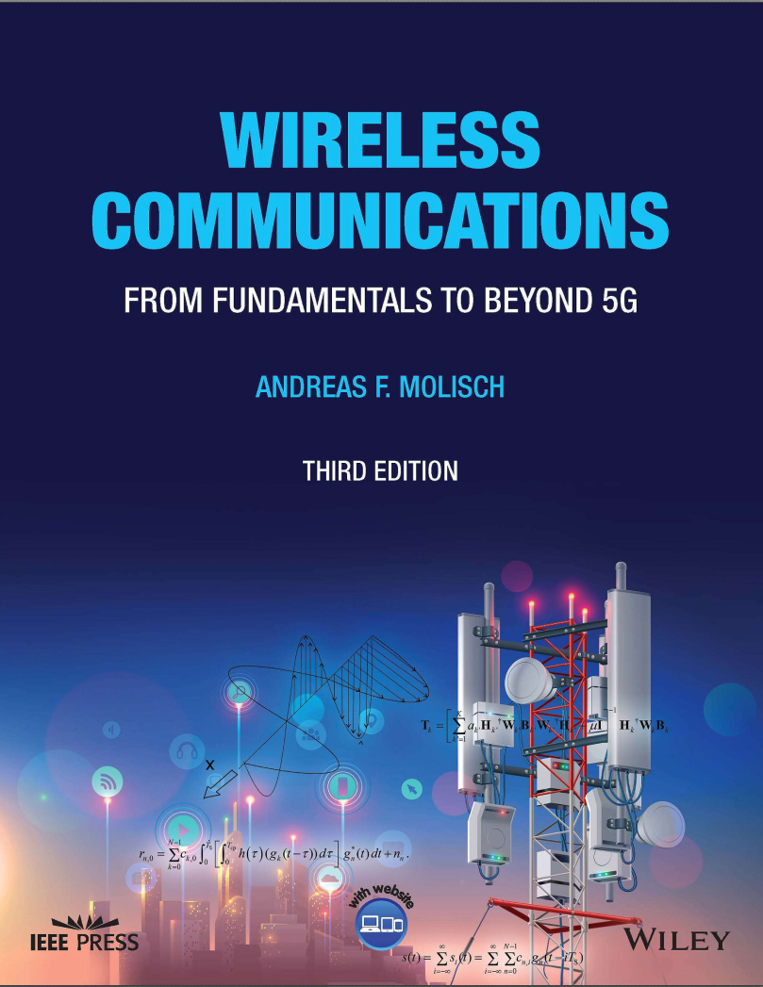
Suggested reading
WIRELESS COMMUNICATIONS
From Fundamentals to Beyond 5G
Third Edition
Andreas F. Molisch
WIRELESS COMMUNICATIONS
Andrea Goldsmith

Slide 3
Breakdown of the content
Introduction and wireless challenges
Wireless System Design Overview
Propagation Effects
Antenna
Statistical Modelling
Wideband Channels & Channel Modelling
Digital Modulation and Demodulation
Diversity
Equalization & OFDM
MIMO Systems
4G, 5G NR & Emerging B5G

Slide 4
Timetable
12 Lectures from week 1 to week 12
8 Labs at week 1-2, 4-5, 7-8 and 10-11
4 Tutorials at week 3, 6, 9 and 12

Slide 5
Assessment
Coursework – 40%
Coursework is submitted online and checked for plagiarism automatically.
Exam – 60%
3 Questions, 25 marks each.
Attempt any 2 out of 3 questions
Please remember to write your name, student ID and Question Number on your answer sheets.
Total duration of exam will be 2 hours

Slide 6
Plagiarism
Passing off someone else’s work as your own, including:
Submitting (e.g.) code that someone else wrote
Paying for someone else to do it for you
Working on a piece of non-group work together as a group, and submitting it as individual work
Sharing of code that you then possibly adapt
If you give someone else your work, you can also be called in for plagiarism

Slide 7
Chapter 1
Introduction

Slide 8
Contents
History of wireless systems
Classifications
Requirements for services
Social and economic aspects

Slide 9
HISTORY OF WIRELESS

Slide 10
History of wireless (1)
Maxwell: theory
Hertz: fundamental experiments confirming Maxwell’s theory
1890-1905: First experiments for wireless information
transmission
– Tesla, Bose, Marconi
1905-1946: First systems:
1947/1948: fundamental information theory

Slide 11
History of wireless (2)
Development of cellular telephony: 1950s – 1980s
Cellular systems
GSM (Global System for Mobile communications)
First deployment in early 1990s in Europe
In 2005, more than 1 billion users
IS-95 (cdmaOne)
Second-generation system based on different multiple-access scheme
Used mainly in US and Korea
PDC (Pacific Digital Cellular)
Third-generation systems
Several different standards
All based on CDMA
Still mainly speech communication, with some data services

Slide 12
History of wireless (3)
After 2008/9 (smartphone era): cellphones mostly for data
(web browsing, social networks).
After 2015: wireless video dominates (now ~70% of all data traffic)
Data traffic starts to explode, voice almost irrelevant for cellular
Data poses different requirements, new types of scheduling, ….
Since 2010: deployment of LTE
Continuous improvements of LTE standard since then
5G: first version of the standard approved in 2018, deployment since then
higher data rates
Massive connectivity (for IoT)
Low latency for control applications, (industry 4.0, tactile internet)

Slide 13
Other wireless systems
Fixed wireless access:
for wireless internet
Not successful in 1990s
In 2000s, WiMax was developed,
Now: mm-wave to compete with cabled connections
Wireless LANs
Wireless access points (WiFi) in most homes, both as “last 10m”,
and for data exchange within the home
WiFi standard, developed from 1 Mbit/s (1997) to 10 Gbit/s (2017)
Personal Area Networks
Bluetooth

Slide 14
TYPES OF SERVICES

Slide 15
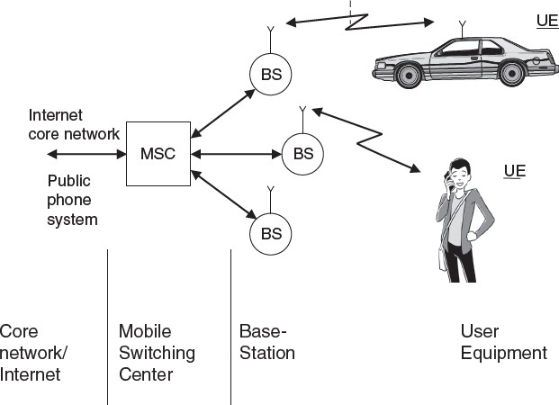
Cellular phones
Variations:
Satellite: much larger cells; expensive base stations Trunking radio: closed user groups

Slide 16
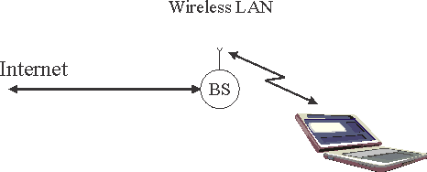
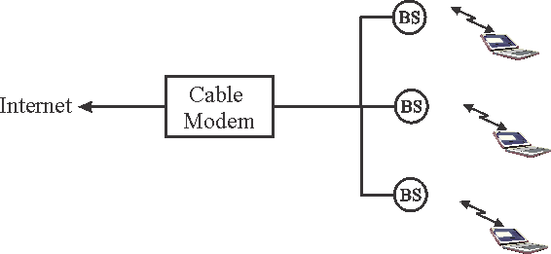
Wireless LAN

Slide 17
Personal Area Network
Very small coverage area
Most important example: Bluetooth
Bi-directional communication
No significant mobility
No coordination between different BSs

Slide 18
Fixed wireless
Fixed wireless systems
Long distances between BS and MS
No mobility requirements
Typically high data rates, but can also be used for voice systems
WiMax standard (IEEE 802.16) did not succeed
Now being deployed: 5G systems based on mm-wave
To compete with cable

Slide 19
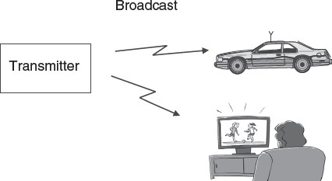
Broadcast

Slide 20
Ad-hoc networks

Slide 21
REQUIREMENTS FOR SERVICES

Slide 22
Data rate
Sensor networks and IoT: <1kbit/s; central nodes need up
to 10 Mbit/s
Speech communications: 5-64 kbit/s, depending in speech coder (vocoder)
Elementary data services: 10-100 kbit/s
Communications between computer peripherals: 1 Mbit/s
Web browsing and data services: peak data speeds and
latency important, 1-100 Mbit/s
Video streaming and conferencing: 0.2-20 Mbit/s
Personal Area Networks: 100 Mbit/s – 10 Gbit/s

Slide 23
Range and number of users
Body area networks: 1m range, one user with <10 nodes
Personal area networks: 10m range, < 10 users
WLANs: range < 100m, number of users up to several 100 (conference room, sports stadium)
Cellular systems: range 100m-10km. Number of active users typically 10-50, but total number of users in hundreds or thousands
Fixed wireless access: range up to 10s of km. Similar number of users as cellular
Satellite systems: range up to 1000s of km, number of potential users in thousands or more

Slide 24
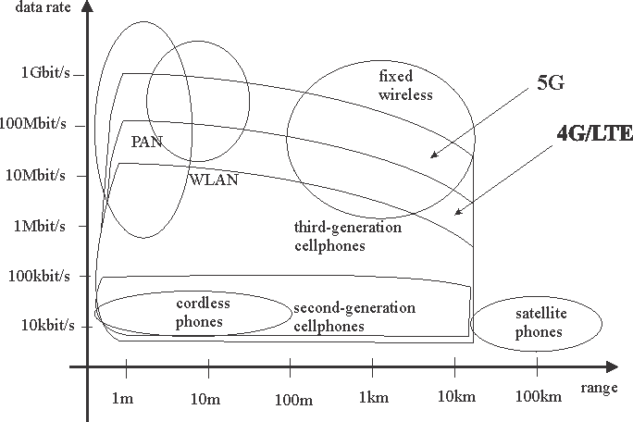
Tradeoff range vs. datarate

Slide 25
Mobility
Fixed devices: stay in one location; temporal variations due
to moving objects in surroundings
Nomadic devices: MS placed at certain location, stays there for a while (WLANs)
Low mobility: pedestrian speeds (cordless phones)
High speed: cellphones in cars
Extremely high speed: high-speed trains, planes, ….

Slide 26
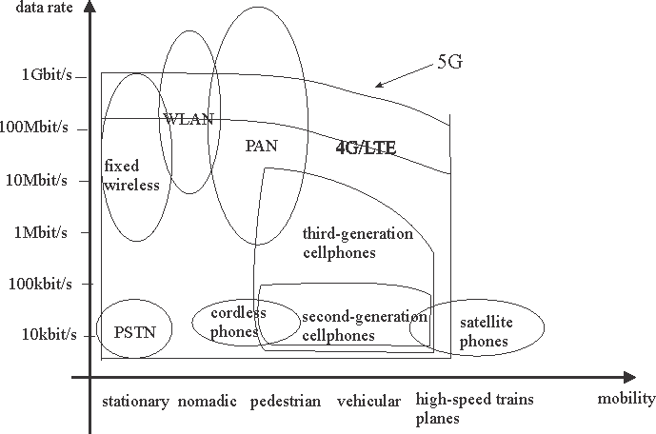
Data rate versus mobility
Notes:
mobility

Slide 27
Energy consumption
Rechargeable batteries:
For nomadic devices, typically wants one charge to last ~16 hours
Battery weight is significant factor
One-way batteries
For sensor nodes.
Lifetime of ~10 years desirable
Motivates extremely low energy design
Power mains
For BS and other infrastructure
Should contain most complexity
Consider operating expenses and need of AC

Slide 28
Spectrum usage
Spectrum dedicated to specific service and operator
Spectrum dedicated to specific service
Free spectrum

Slide 29
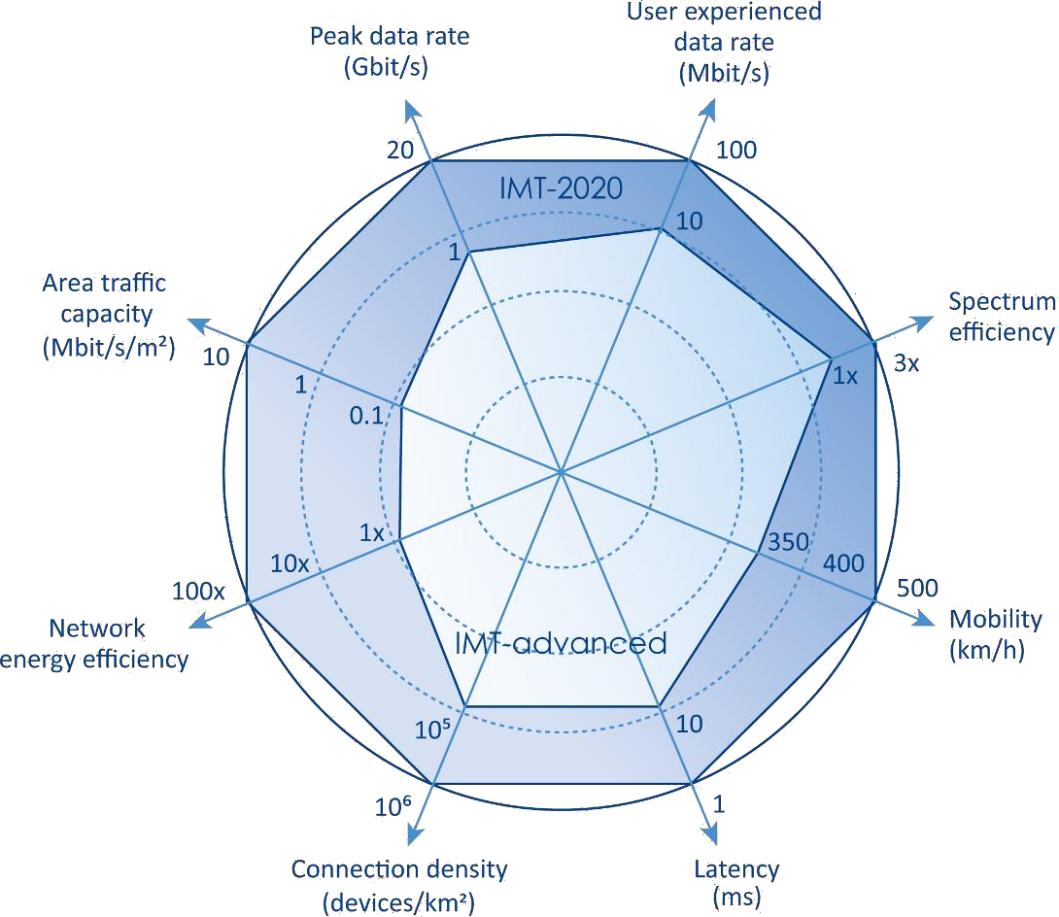
Requirements for 5G

Slide 30
ECONOMIC AND SOCIAL IMPACT

Slide 31
Economic requirements
Systems where mobility is a value by itself
Cellphones, etc.
Can charge premium for service
Systems that just are cable replacement
E.g., for fixed wireless access
Must be cheaper than cabled service
In either case, quality has to be same than wired
Tradeoff between economies of scale in general-purpose systems and performance improvement by custom-made solutions

Slide 32
Behavioral impact
Communications are now with a person, not with a location
Allows more flexibility for private/business life, but can also become burdensome due to constant reachability
Cellphone etiquette: generally underdeveloped
Phoning and especially texting while driving is extremely dangerous
Each cellphone has an OFF button

Slide 33
Chapter 2
Technical challenges of wireless communications

Slide 34
The major challenges
Broadcast effect
Multipath propagation
Spectrum limitations
Limited energy
User mobility

Slide 35
Broadcast effect
Signal sent out by the TX antenna is transmitted into all
directions
Advantage: can reach multiple users without requiring extra energy
– Exploited in broadcast TV/radio
Drawback: creates interference at other receivers in the area

Slide 36
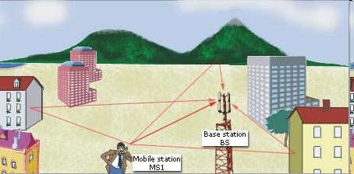
Multipath propagation

Slide 37



Small-scale fading
Signal on reflected
path arrives later
TX
Signal on direct
path arrives first
RX
Constructive (self-)interference
Destructive (self-)interference
+
=
+
=

Slide 38




Large-scale fading
Received power at distance d [log scale]
D
C
d
B
Position
C
A
A
B
C

Slide 39
Consequences of fading
Error probability is dominated by probability of being in a
fading dip
Error probability decreases only linearly with increasing SNR
Fighting the effects of fading becomes essential for wireless transceiver design
Deterministic modeling of channel at each point very difficult
Statistical modeling of propagation and system behavior

Slide 40
Intersymbol interference (1)
Channel impulse response is delay-dispersive

Slide 41





Intersymbol interference (2)

Slide 42
Spectrum assignment
<100 MHz: CB radio, pagers.
100-700 MHz: broadcast (radio and TV)
400-500 MHz: cellular and trunking radio systems
700-1000 MHz: cellular systems (analogue and second- generation digital); emergency communications
1.8-2.0 GHz: main frequency band for cellular and cordless
2.4-2.5 GHz: cordless phones, wireless LANs and wireless PANs (personal area networks); other devices, e.g., microwave ovens.
3.3-3.8 GHz: fixed wireless access systems
4.8-5.8 (7.2) GHz: wireless LANs
6-8, 10-15 GHz: satellite TV
24-300 GHz: mm-wave for communications and radar

Slide 43
Frequency reuse
Available spectrum is limited
-> the same frequency (range) has to be used at many different locations
Regulated spectrum:
a single operator owns the spectrum, and can determine where to put TXs
cell planning so that interference adheres to certain limits
Unregulated spectrum:
Often only one type of service allowed,
Nobody can control location of interferers
Power of interferers is limited by regulations

Slide 44
Limited energy
Power amplifier efficiency: impacts modulation format
Energy saving signal processing
High sensitivity of Rx allows to lower Tx power
Use power control
Foresee sleep mode

Slide 45
User mobility
User can change position
Mobility within one cell (i.e., maintaining a link to a certain BS): mostly effect on propagation channel (fading)
Mobility from cell to cell:

